Slide 1
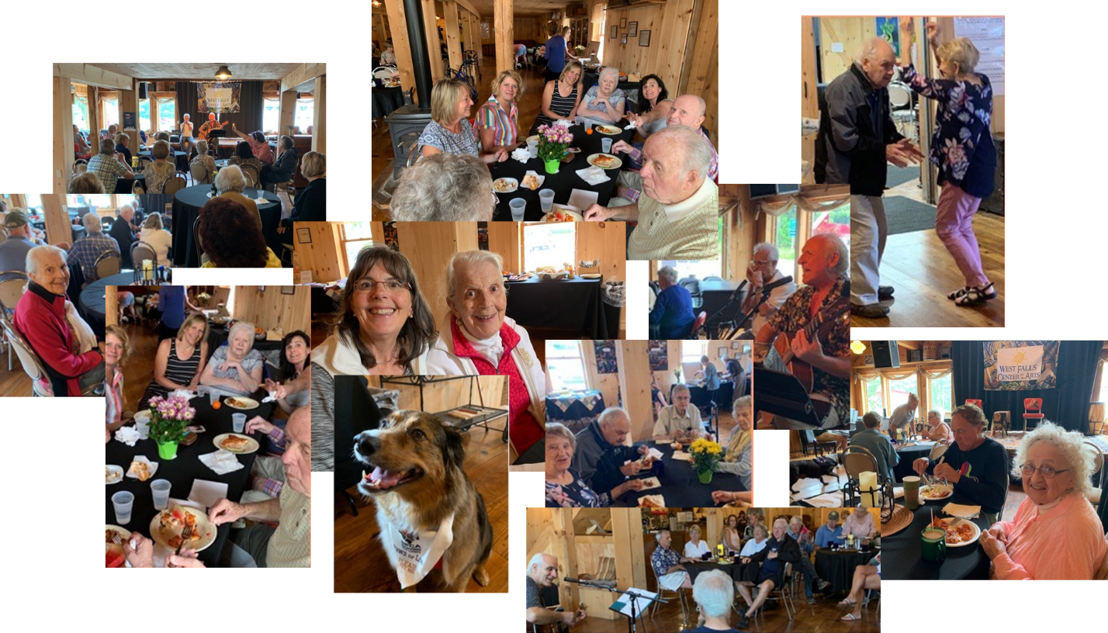
Musical Memories
Café

Slide 2
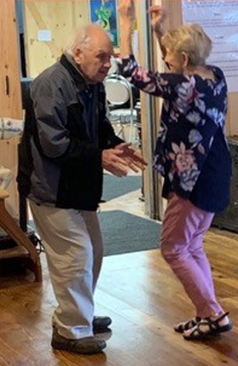
Musical Memories
Café
Musical Memory Café is a concert series for caregivers of older adults that combines caregivers and loved ones in a common, musical experience.
Partners include but are not limited to:
Alzheimer’s Association
Amherst Senior Center
Dale Association (new)
Niagara County Department for the Aging (new)
Boston (NY) Fire Department (new)
Paws for Love – SPCA Serving Erie County
Buffalo Music Hall of Fame
Elderwood Assisted Living
Tennyson Ct. (Assisted Living)
Erie County Senior Services

Slide 3
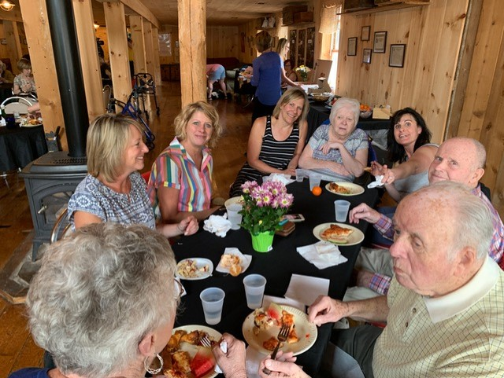
Musical Memories
Café
The program evaluation is a pre/post test design using:
Caregivers Intensity Index (CII)
78 caregivers for WFCFAs
Will send to partners’ participants too
NYAM Program Evaluation
Demographic Questions
Program Specific Questions
Targeted evaluation of Nursing Home/Assisted Living residences that bring individuals with dementia or Alzheimer’s
The CII and NYAM PE will be linked through a Participant ID and administered two weeks apart, with post-test occurring 3 months after pre-test.

Slide 4
Musical Memories
Café
Early Caregiver Feedback
To the statement: “Today’s Memory Café increased my knowledge of community resources.” 87% Agreed (33%) or Strongly Agreed (54%).
To the statement: “Because of today’s experience, I increased my network among other caregivers.” 77% Agreed (41%) or Strongly Agreed (36%).
To the statement: “After today’s experience, I feel less stressed.” 95% Agreed (46%) or Strongly Agreed (49%).
To the statement: “Today’s Memory Café has provided me strategies to reduce stress in the future.” 86% Agreed (44%) or Strongly Agreed (42%).
To the statement: “Today’s Memory Café has helped me to become more confident as I care for my loved one.” 92% Agreed (49%) or Strongly Agreed (43%).
To the statement: “Today’s Memory Café taught me new strategies that I will implement in the future as I care for my loved one.” 86% Agreed (43%) or Strongly Agreed (43%).
To the statement: “Overall, I would highly recommend the Memory Café to other Caregivers.” 100% Agreed (15%) or Strongly Agreed (85%).
To the statement: “I am satisfied with my experience today.” 100% Agreed (18%) or Strongly Agreed (82%).

Slide 5
Musical Memories
Café
Testimonial
Dear Carolyn,
We wanted to share this gift, an unsolicited $1,000 donation, to you and the Memory Cafe in honor of our mom, Jerilynn. The biweekly music, food, and camaraderie that the Memory Cafe offered to my mom, as well as several friends, was truly the highlight of her week. As you recall, mom whistled and sang along as much as she could, and the smiles of joy on her face were priceless to us. We are truly grateful for the passion you have in your heart to share with the community and hope to help continue to share with others like Jerilynn in the future. Thank you for starting the Memory Cafe and for bringing smiles to my mom’s face a few times a month!
With gratitude, Julie, Jill, and Jennifer

Slide 6
Musical Memories
Café
Lessons Learned
FourSight has been extremely helpful
Creative Problem Solving is essential for overcoming more difficult challenges
Expertise is priceless, particularly as an objective perspective
Growth is great but too soon can create challenges
Key to addressing growing too soon is communication, communication, and communication
Culture eats strategy for breakfast
Having a plan that’s goal based, measurable, and ambitious helps to drive innovation and success

Slide 7
Musical Memories
Café
Creative Problem Solving
Creating a name and brand for our program
Note: we did this online using Zoom and Stormboard and it worked incredibly well!
Having all four types in the FourSight was helpful to our CPS process (particularly at the end)
Using a marketing expert who has an objective perspective was extremely helpful to the process
Using an expert in CPS was extremely beneficial
Future: Expanding to isolated adults

Slide 8
Musical Memories
Café
Sustainability Ideas
Licensing Model (Building a Community of Licensees and Caregivers)
License MMC for a modest cost ($1,250 to $1,500)
Provide licensee resources and supports that have a vale significantly above licensing fee
Annual fee after first year ~$900
Consulting Model:
Provide consulting for a minor fee including but not limited to grant writing, evaluation, coaching, outreach/marketing, etc.
Beta-site Model
Secure grants to continue to improve program then share those findings with licensees
MCO Reimbursement

Slide 9
Musical Memories
Café
Current Challenges
Expanding/Licensing Prior to Completion of Supports
Communicated to expansion sites that we would be ready by Jan 2022 and that they would not be assessed a fee until then.
Our licensees are going to partner with us in the development of supports and consulting services
Future Challenges
Expanding to Isolated Adults
Will leverage Teresa Lawrence to do Creative Problem Solving around:
Outreach, retention, and partnerships

Slide 10
Musical Memories
Café
Lessons Learned
Building a web site is a complex process that goes beyond the content that will comprise the public pages.
Bouncing back from COVID takes time but with perseverance, we are making progress with increasing audience size.
The benefit is greater than we expected.
Going Well
Expansion is going very well!
Marketing and media attention has grown.
Increasing audience sizes slowly but surely.
Partners have played a valuable role in our continuous quality improvement and expansion activities.

Slide 11
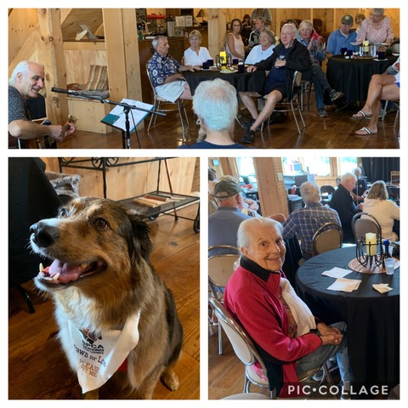
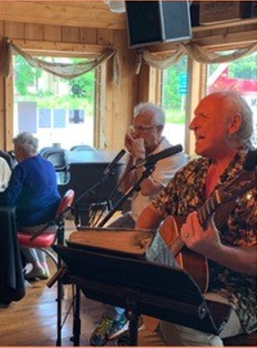
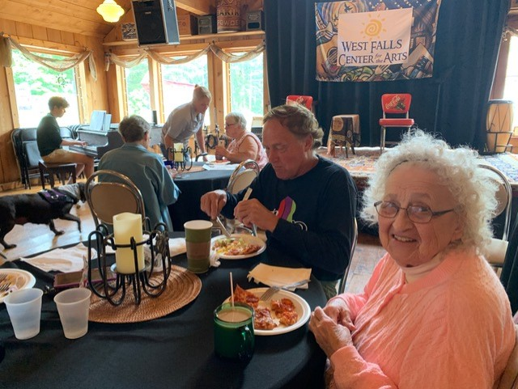
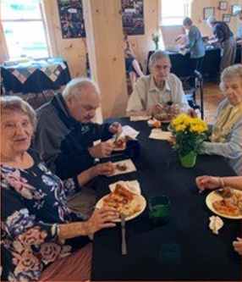
Musical Memories
Café
Next 6 Months
Build our website
Develop Logo
Complete Consulting Services
Expand to Isolated Adults
Use the Evaluation to Improve Program
Develop the separate “Communities” for Licensees and for Caregivers

Slide 12
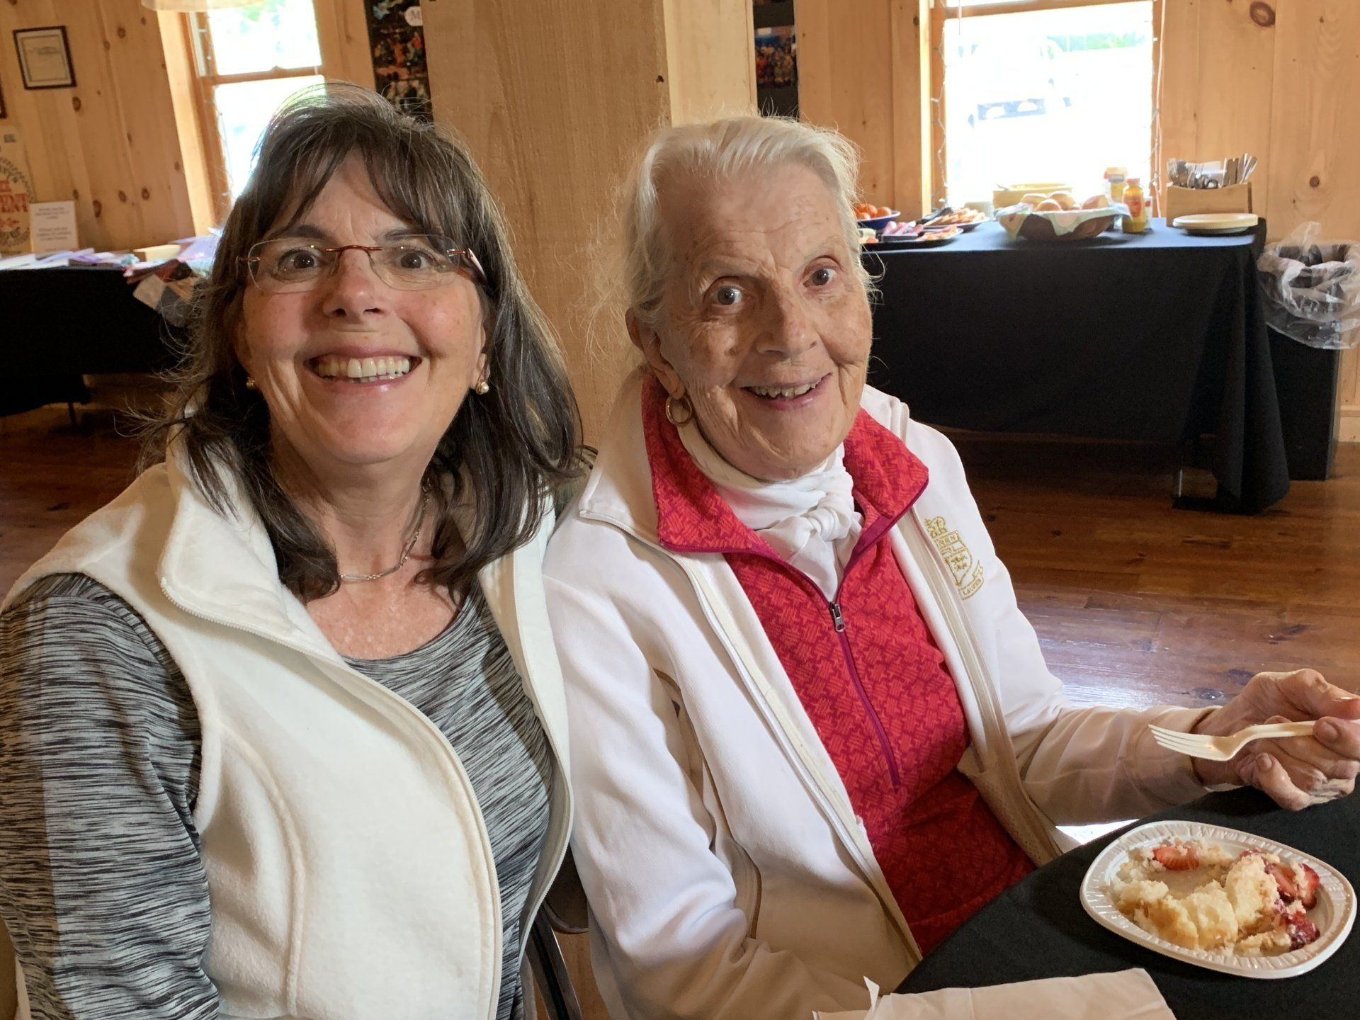
Musical Memories
Café
Questions?

